Slide 1
Rocket Motors

Slide 2
How Engines Work
In order for something to burn, you need a fuel + oxidizer
Fuel – the chemical that burns
Oxidizer – the thing that causes the burning
Compare this to airplanes
Where is their oxidizer?
Motor vs engine
Notes:
Motor is simple device that stores propellant, engine is more complicated with moving parts to convert stored propellant into thrust

Slide 3
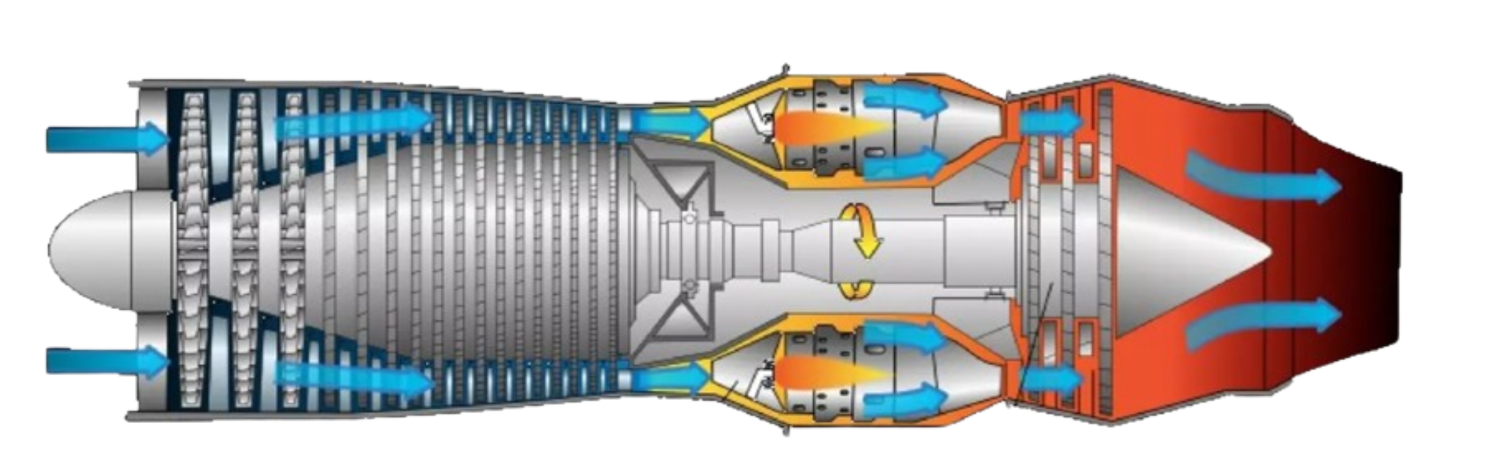
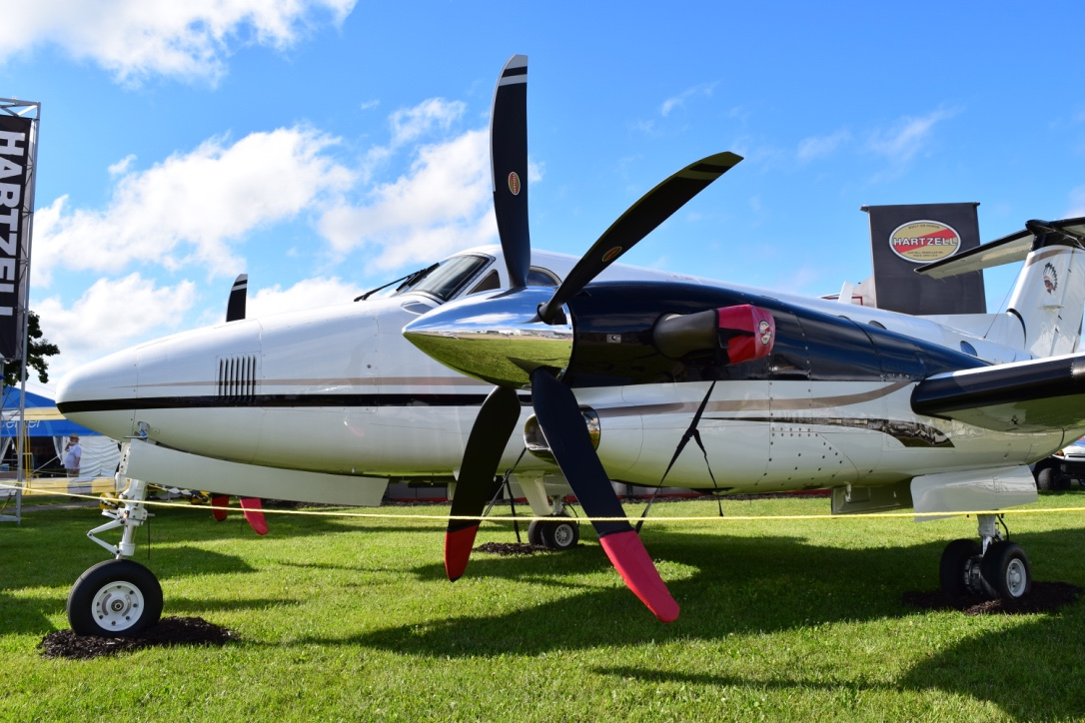
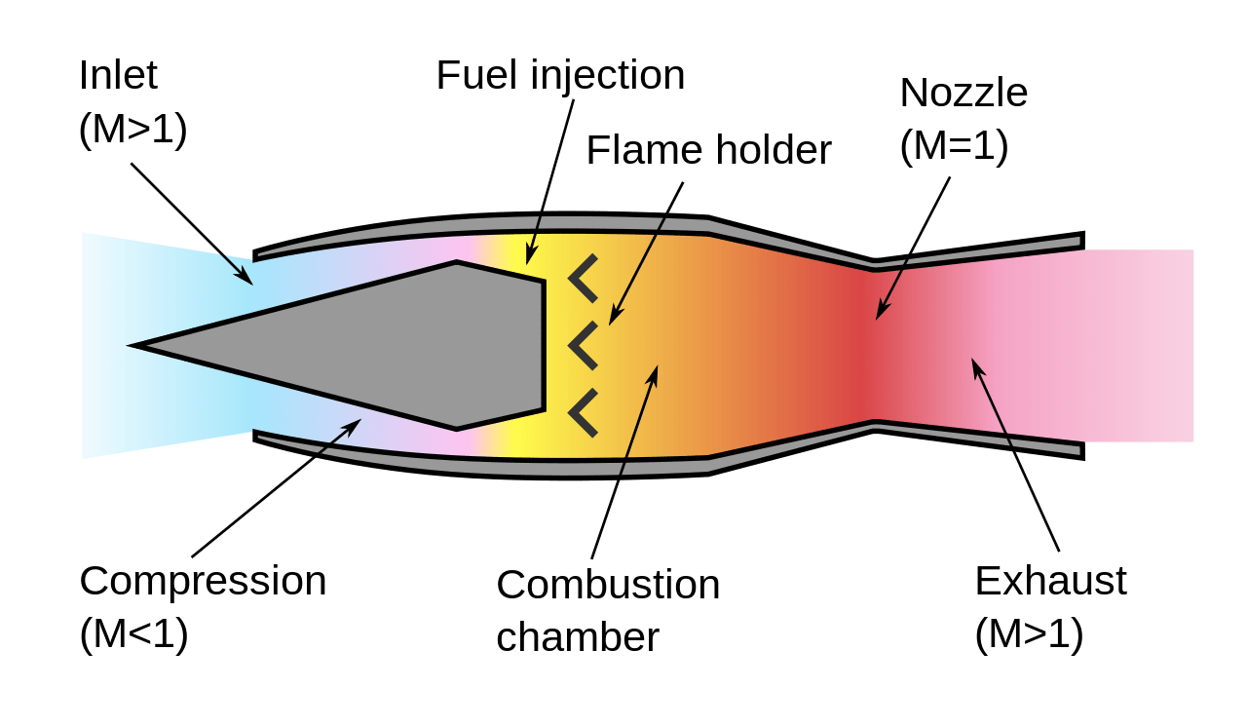
Airplane Motors
Notes:
Turboprop: Normal engine drives a propeller, the propeller propels air back, generating thrust
Turbojet engine: Air gets intake, compressed, fuel added, burned, and then expelled
Ramjet: Air gets compressed due to the aircraft going a high speed – aircraft using it normally need assistance to get up to speeds because ram jets have low efficiency at low speeds
All 3 work by expelling air backwards

Slide 4
Rocket Propulsion
Solid Fueled Rockets
Liquid Fueled Rockets
Hybrid Rockets
Notes:
Have students guess which ones

Slide 5
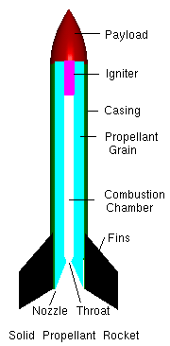
Solid Propulsion
Solid Fueled Rockets
Liquid Fueled Rockets
Hybrid Rockets
Notes:
Importance of nozzles

Slide 6
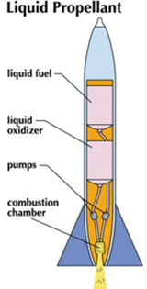
Liquid Propulsion

Slide 7
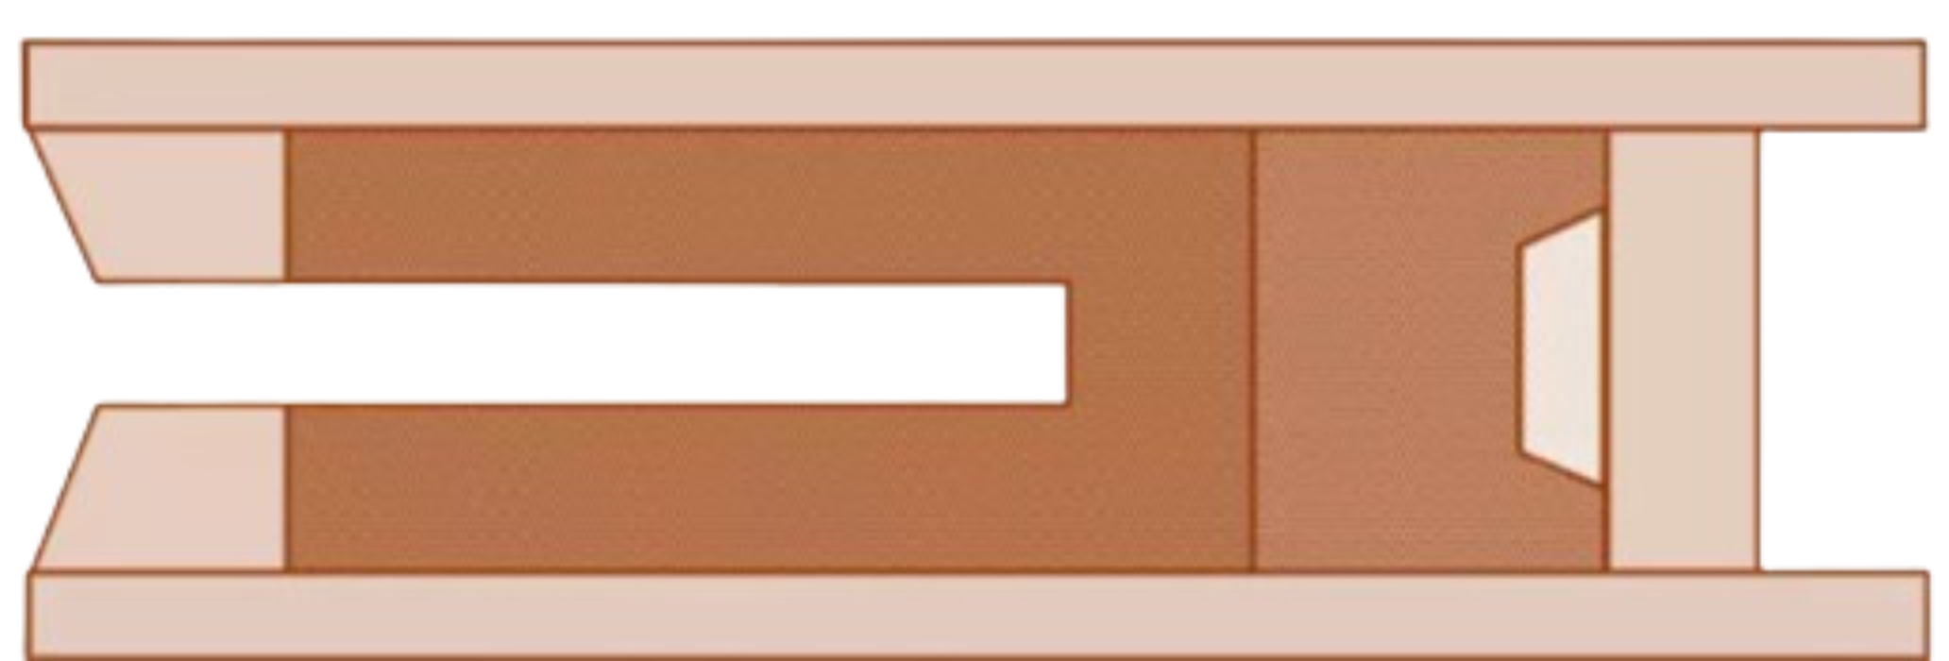
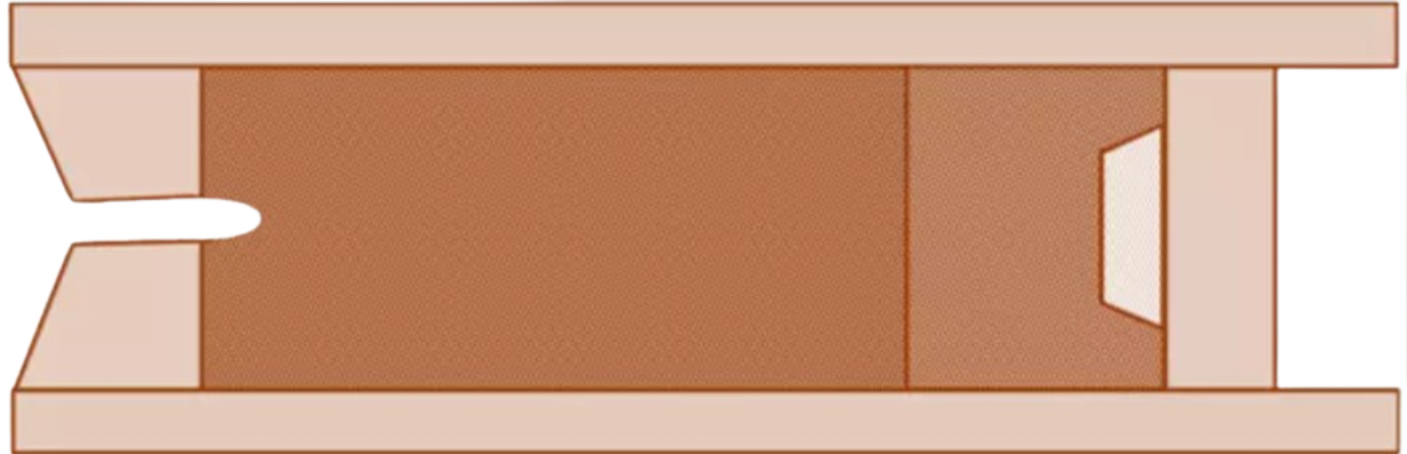
Core Burning vs End Burning
Notes:
However, to get higher thrust, the hollow core is used. This increases the surface area of the propellants available for burning. The propellants burn from the inside out at a much higher rate, sending mass out the nozzle at a higher rate and speed. This typically results in greater thrust.
End burning – easier to manufacture, longer burn time, but can lift less payload

Slide 8
Chemical Reactions
Combustion:
Liquid hydrogen + liquid oxygen
Gunpowder
Alcohol + Oxygen
Acid/base:
Baking soda + vinegar
Alka seltzer + water
Notes:
Liquid hydrogen and oxygen combine to turn into water, releasing energy and hot gasses that get expelled, producing thrust
Gunpowder – charcoal is fuel, potassium nitrate is oxidizer
Baking soda + vinegar produce CO2, and that gas gets expelled, producing thrust
Alka seltzer contains both the base and the acid – citric acid and sodium bicarbonate ( baking soda) – water is just a catalyst – reaction also releases CO2

Slide 9
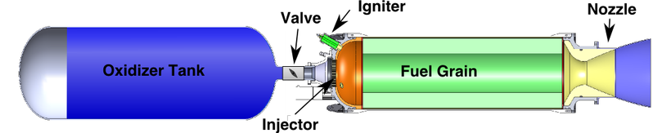
Hybrid Propulsion

